Slide 2
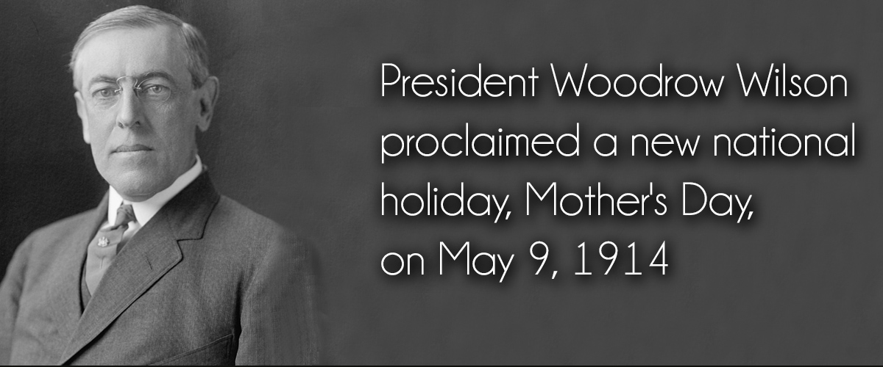
122 Million Americans will call their mother today
113 Million Mother’s Day cards will be given

Slide 3
THOUGHTS ON MOTHERHOOD
Exodus 20:12
“Honor your father and mother”

Slide 4
“A Mother’s Work From A to Z”
A- Artist, arrange & beatifies the home
B – Beautician – clips, cuts & curls
C – Chauffeur – shuffles all the family
D – Dietician – plans endless menus
E – Engineer – keep wheels oiled
F – Fashion Designer – alters hand me downs & creates originals
G – General Practitioner – treats everyone
H – House Keeper – straightens, cleans
I – Information Bureau – Answer questions
J – Judge – settles disputes
K- Keeper at home – seeks her God-given roll – Titus 2:5
L – Laundry Worker – “ring around collar”
M – Musician – sings lullabies

Slide 5
“A Mother’s Work From A to Z”
N – Nurse – vigil beside sickbeds
O – Organizer – parties, ball games
P – Pharmacist – band-aids, aspirins
Q –Queen of the home – center of home
R – Recreational Director – Plans activities for school
S – Seamstress – patches, mends, etc
T – Teacher – instructing little minds
U - Upholsterer – recovers old furniture
V - Vocational Counselor – good advice
W - Waitress – over 1,000 meals a year
X - X-Ray Technician – sees through excuses, evasions, coverups….
Y - Yard Worker – plants, prunes, etc
Z - Zoo Keeper – feeds pets the children promised they would take care of

Slide 6
THOUGHTS FROM THE BIBLE ON MOTHERHOOD
Exodus 20:12 “Honor your father and your mother”
Leviticus 19:3 “Every one of you shall revere his mother and his father..”
THE BEARER OF A LIFE THAT HAS COME FROM GOD!
A co-worker with Divinity – Genesis 4:1

Slide 7
THOUGHTS FROM THE BIBLE ON MOTHERHOOD
ENCOURAGEMENT AND COMFORT
Isaiah 66:13 “As one whom his mother comfort…”
BUSY TAKING CARE OF HER FAMILY
Proverbs 31:13-18 “She perceives that her merchandise is good, And her lamp does not go out by night.”

Slide 8
THOUGHTS FROM THE BIBLE ON MOTHERHOOD
HER TEACHING WAS NOT TO BE FORSAKEN
Proverbs 1:8 “do not forsake the law of your mother.”
NOT TO BE DESPISED, MOCKED OR SCORNED
Proverbs 15:20 “foolish man despises his mother.”
Proverbs 17:25 “A foolish son is…bitterness to her who bore him.”
Proverbs 19:26; 23:22; 30:17

Slide 9
THOUGHTS FROM THE BIBLE ON MOTHERHOOD
MOTHERHOOD NOTE MERELY A BIOLOGICAL FUNCTION- ALSO A SACRED CALLING – Isaiah 49:15
TO BE EXPERIENCED ONLY IN MARRIAGE
Traditional Family – 17.8% Single Parent Homes 25%
Step Families 16% Single Mothers 40%
Mother of 3 “I’m not ready for marriage yet, but I love children and wanted to have them.”

Slide 10
THOUGHTS FROM THE BIBLE ON MOTHERHOOD
SEXUAL RELATIONS OUTSIDE OF MARRIAGE ARE SINFUL – Hebrews 13:4 “ fornicators…God will judge.”
1 Corinthians 6:9 “unrighteous will not inherit the kingdom of God? … fornicators”
Matthew 1:18,19 “Mary was betrothed to Joseph, before they came together, she was found with child of the Holy Spirit… being a just man, and not wanting to make her a public example, was minded to put her away secretly.”
MOTHERS TO LOVE THEIR CHILDREN – Titus 2:4

Slide 11
THOUGHTS FROM THE BIBLE ON MOTHERHOOD
MOTHERS ARE TO TEACH THEIR CHILDREN ABOUT THE LORD
2 Timothy 3:14,15 “genuine faith that is in you, which dwelt first in your grandmother Lois and your mother Eunice, and I am persuaded is in you also.”
GREAT BLESSINGS ARE IN STORE FOR GODLY MOTHERS
THE GREATEST HONOR YOU CAN GIVE YOUR MOTHER IS TO LIVE BY THE PRINCIPLES TAUGHT IN THE BIBLE

Slide 12
TO BE A GREAT MOTHER:
M
O
T
H
E
R
MARRY THE RIGHT MAN
OBEY THE GOSPEL
TRAIN YOUR CHILDREN TO LOVE GOD
HONOR YOUR PARENTS
ENJOY BEING A CHRISTIAN
REQUEST WISDOM FROM GOD

